Slide 1
STAYZE – Rent Prediction TEAM – DATA BLITZ
Dashang Makwana
Nevina Dalal
Simran Mulani
Vishakha Singh

Slide 2
Problem Statement
We are provided with all the demographics for Stayze; about which all properties/houses are associated with it, their locations and other such details. We are asked to study the data and Predict the Rent.

Slide 3
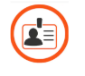
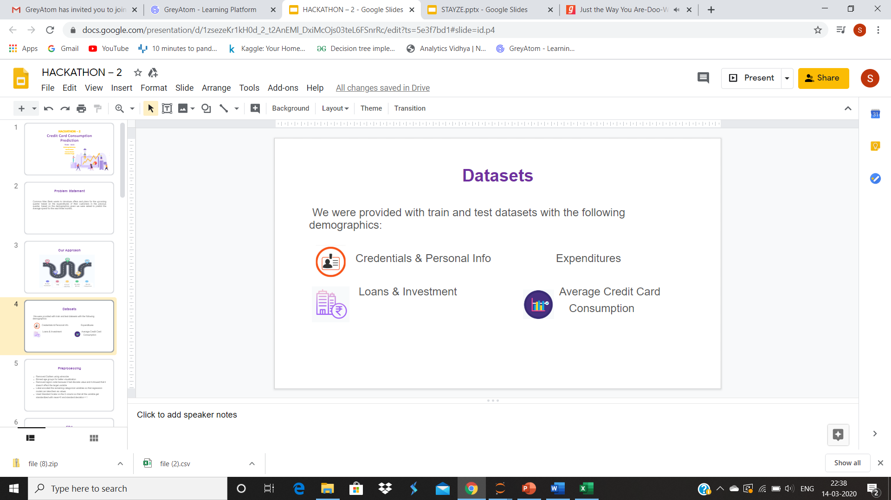
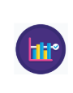

Datasets
We were provided with the Train and Test datasets with the following information and details:
ID, Name Details of the host
Price Reviews, availability etc.

Slide 4
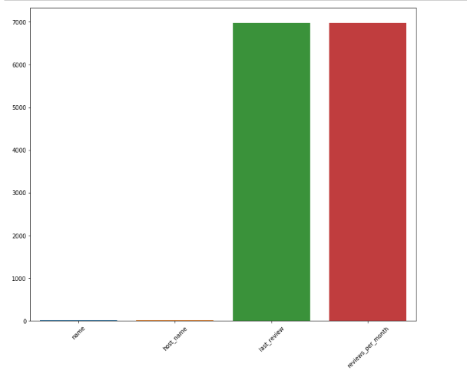
Pre-processing
Removed unwanted variables : name and host name
Replaced missing values in reviews with 0
Label encoded the Category columns :neighbourhood, neighbourhood group, room type

Slide 5
Descriptive Statistics
We are considering 34226 rows in the train data
The price of the listing ranges from 0 USD to 10000 USD, with a mean price of 153 USD and a standard deviation of 243 USD suggesting a very broad price range distribution.
Availability of the property ranges from a day to all year round, with a median of 44 days.

Slide 6
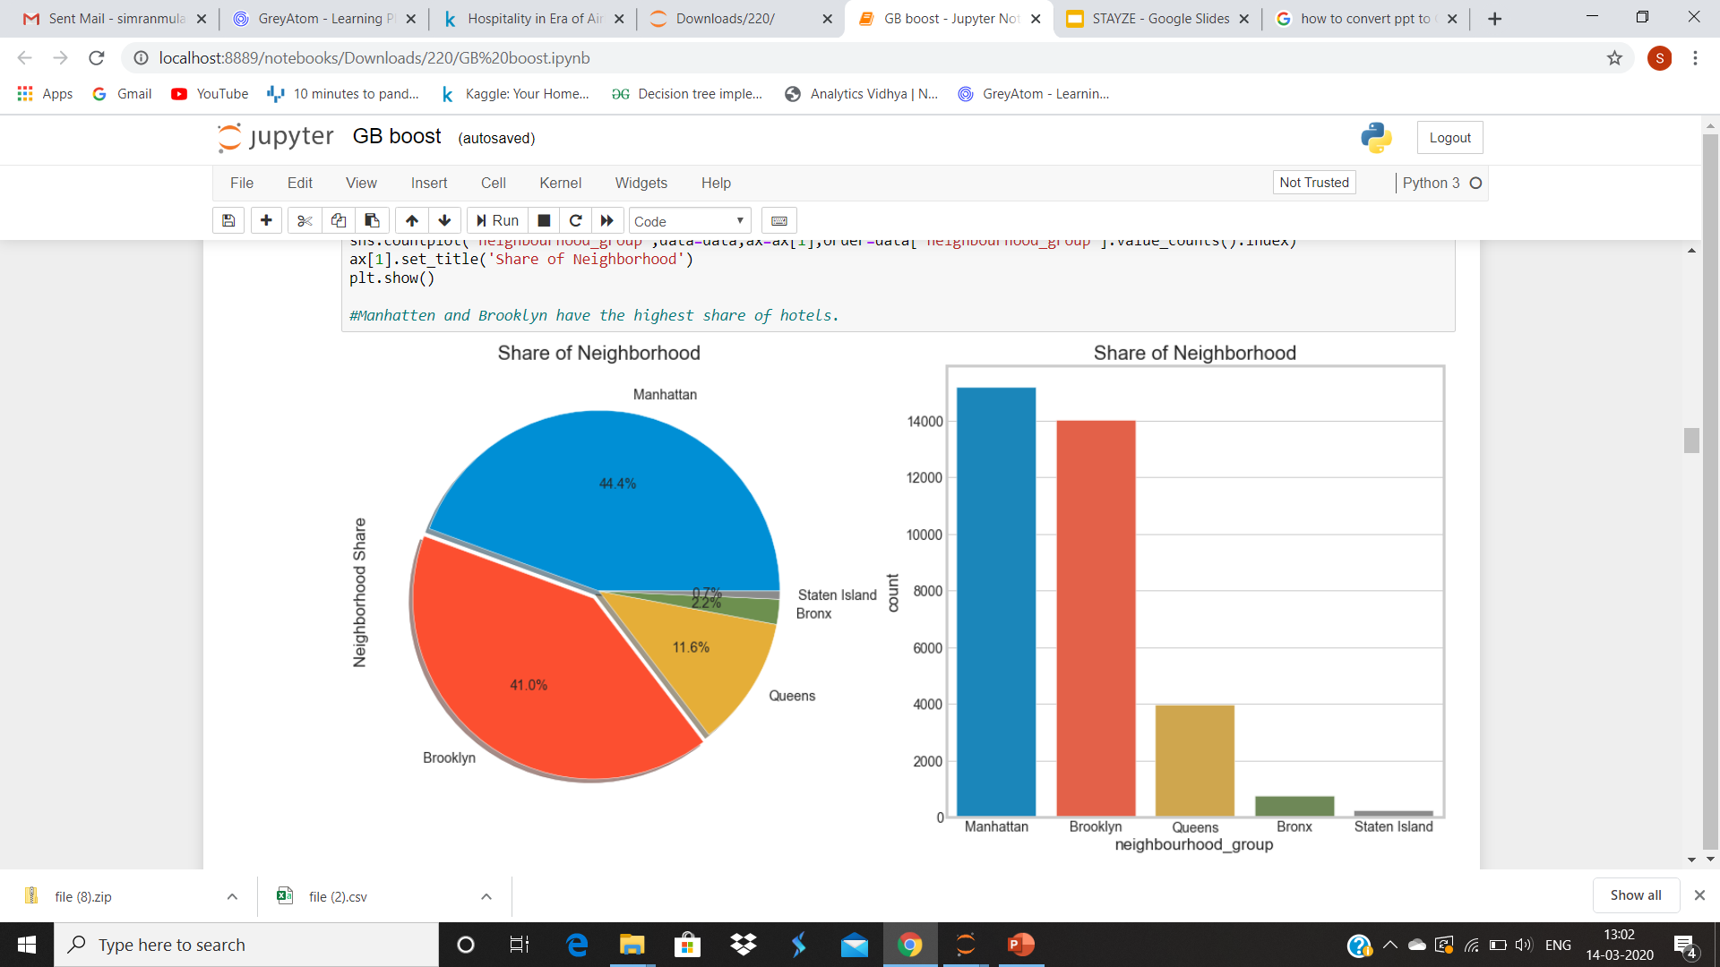
Neighbourhoods
Clearly through this graph we understand that predominantly Stayze has more property in Manhattan and Brooklyn

Slide 7
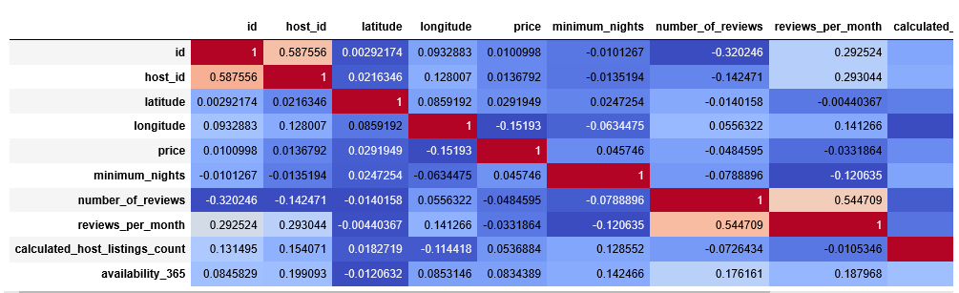
Correlation
No strong correlation except number_of_reviews vs reviews_per_month
Longitude is slightly negatively correlated with the price which could suggest that as we move west the prices increase

Slide 8
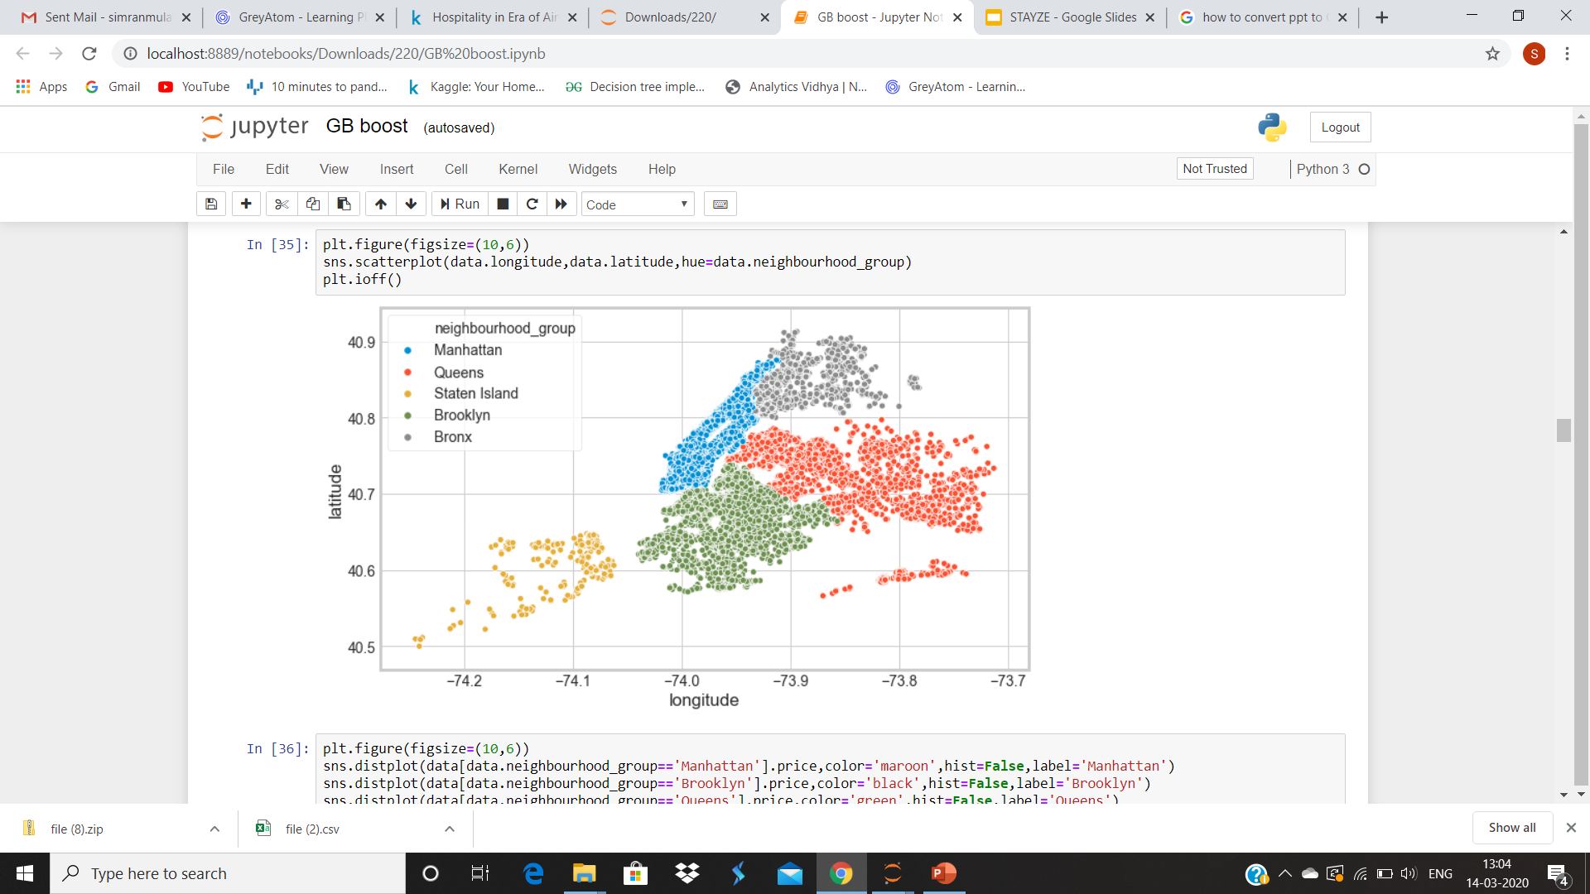
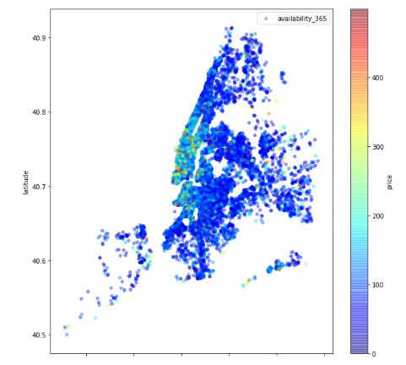
Area Wise Distribution of Price
Prices in more popular areas like Manhattan and Brooklyn are more. The properties in these areas are also available for lesser number of days.

Slide 9
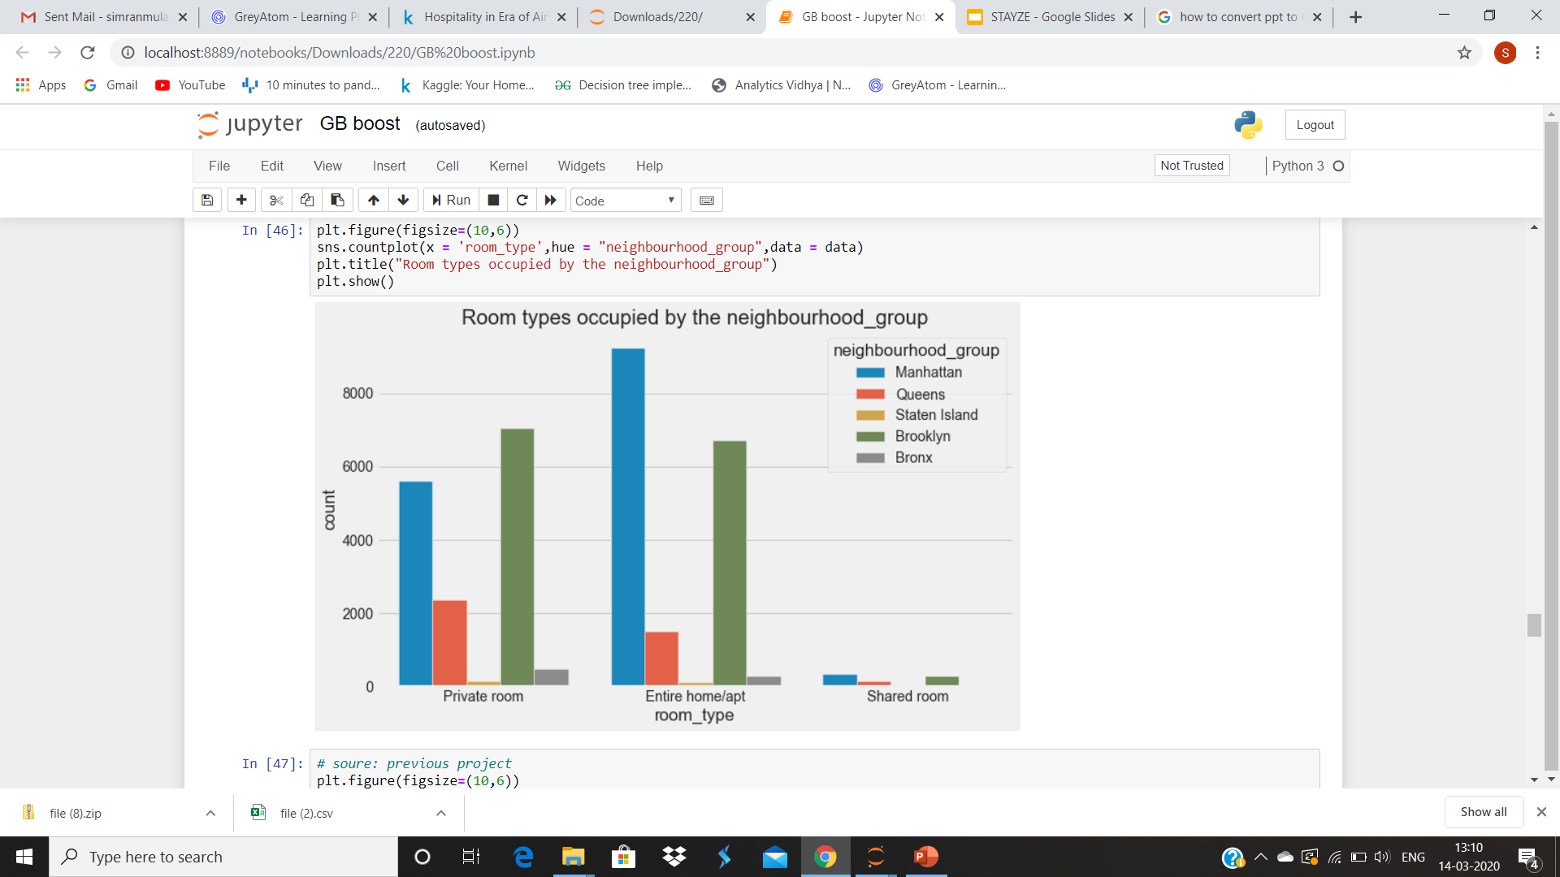
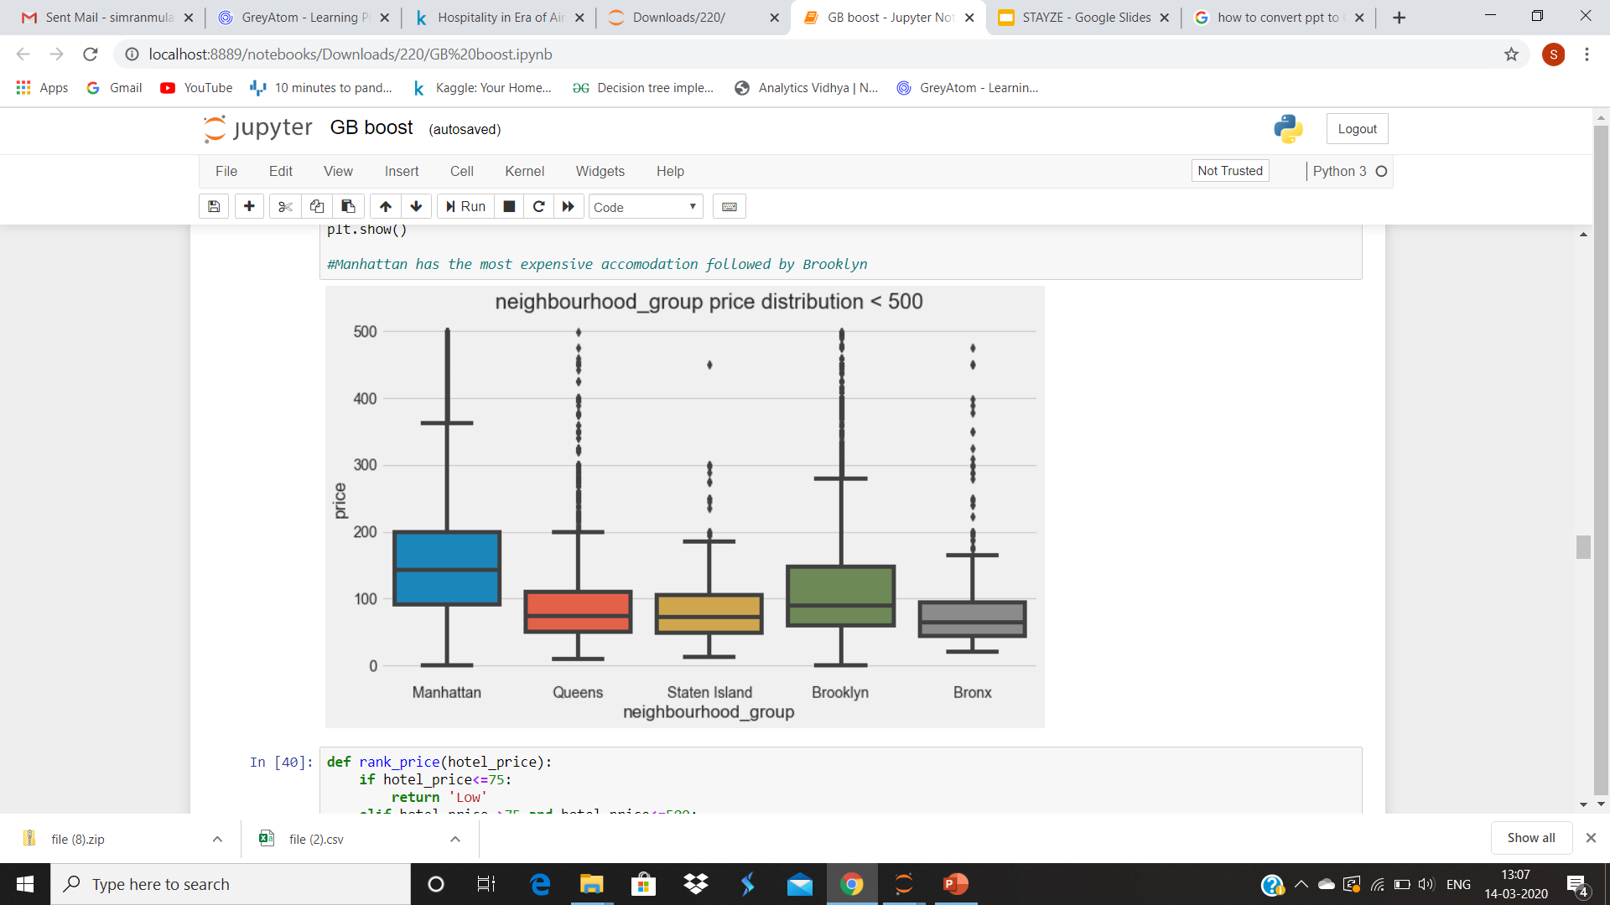
Room Type in Each Neighbourhood
From the above graph we can deduce that people prefer Private rooms and Entire-house over Shared rooms
From the above graph we can see that Manhattan and Brooklyn seem to have uniform prices whereas others seem to have prices that vary a lot

Slide 10
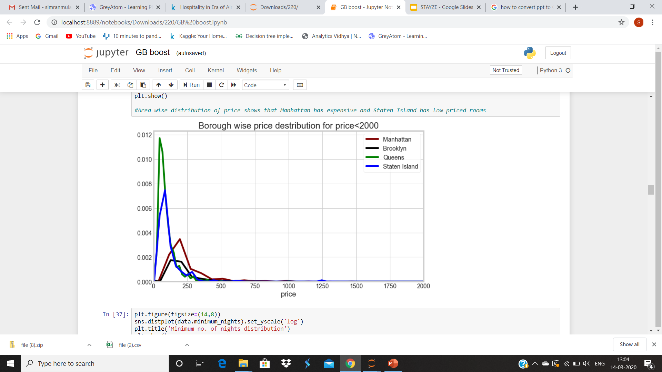
Distribution of Prices
Area wise distribution of price shows that Manhattan has expensive and Staten Island has low priced rooms

Slide 11
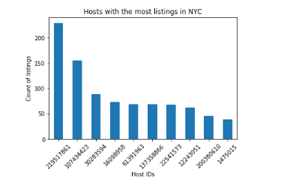
Top 10 Hosts
9 / 10 Host ID’s are situated in Manhattan
9 / 10 Host ID’s belong to the ‘Entire Home’ Room type
5 / 10 Host ID’s have availability of 300+ days out of 365days

Slide 12
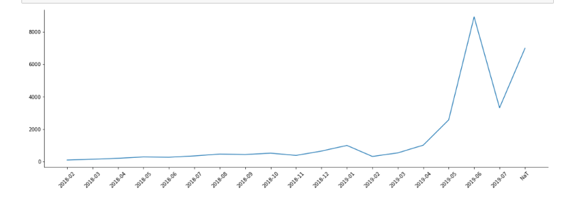
Last Reviews of listings
Plotted the last review in months and saw that most of the properties were given their last review in May 2019 which could suggest that the summer is the peak for visitors to stay in New York or enough data of the previous year was not captured.

Slide 13
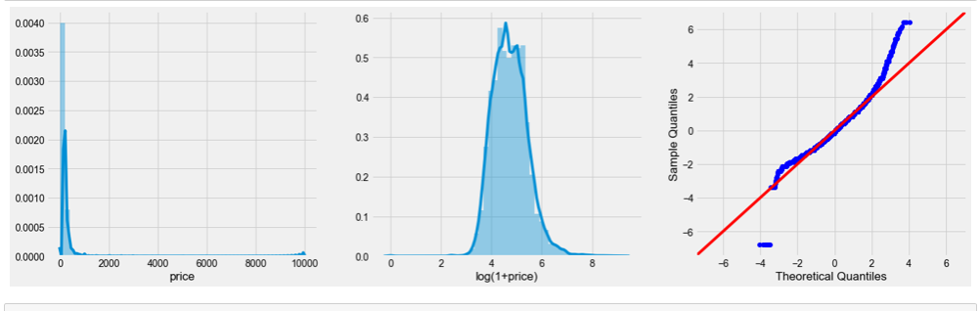
Skewness in Price
Log transformed price for some of models to remove skewness

Slide 14
Models Used
Models | Test RMSE | Platform Result
Linear Regression | 234.97 | 222.36
Gradient Boosting Regressor | 143.058 | 217.11
Random Forest Regressor | 139.897 | 220.12
Random Forest with Search CV | 223.14 | 211.1
Random Forest with Feature Selection | 232.51 | 233.86
Lasso | 109.370 | 234.82
Ridge | 135.648 | 222.27
Bagging | 138.513 | 220.69
Adaboost | 209.96 | 233.24
XG Boost | 174.837 | 212.37
Random Forest with Feature Selection and Randomized Search CV | 223.56 | 213.07

Slide 15
Business Insights
Manhattan is the most expensive among all areas whereas Bronx is the least priced one
People generally go for Entire houses or private rooms over shared rooms hence their prices could accordingly be changed depending upon the demand

Slide 16
Additional Data for better Insights..
If the following data was also provided we would’ve been able to explore the data in more depth:
1. Property Specifications :
area, room amenities, parking space, society amenities, smoking area, no. of beds, ppl capacity)
2. Review category : good/bad
3.Host data : personal details , profession

Slide 17
More Business problems that could be solved..
Customer(home owner) attrition
Leverage reviews
Dynamic pricing
How to on-board new home owners for the company

Slide 18
THANK YOU

